Slide 2
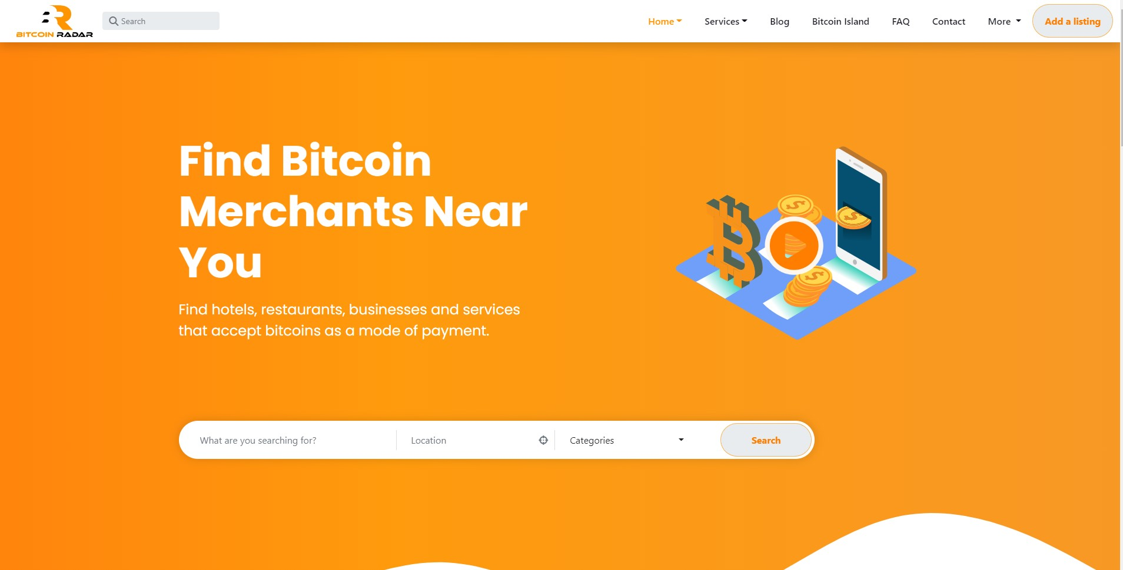

BITCOIN RADAR PHILIPPINES
MINI-1 PROJECT
PRESENTATION

Slide 3
WD31 GROUP-8
Senior Dev: Alden Panganiban Vidal
Junior Devs: Marc Ernest Bagu Kagahastian Mark Joseph Libres Ortizano

Slide 4
Objective / Use Cases
Help users to find businesses and services that accept bitcoin as mode of payment.
Provide merchant’s location, information, many more.
Promote, boost and help businesses reach more exposure and engagement.
Bookings can only be done for services that are premium members.
Soon this website will help a lot of Bitcoin users, communities and businesses.

Slide 5
What Is Bitcoin?
Bitcoin was created as a way for people to send money over the internet. The digital currency was intended to provide an alternative payment system that would operate free of central control but otherwise be used just like traditional currencies.
Bitcoin is so powerful and has so much potential, Bitcoin's projected value and estimated growth could be astronomical. Speculation from crypto analysts and industry experts suggests that Bitcoin's long-term value could reach over $100,000 to as much as one million dollars per BTC in the future.

Slide 6

Thank You!

